Slide 1
Unit-1
Digital Image Processing – Introduction
Ref. Book – Gonzalez, R.C and Woods, 3rd Edition

Slide 2
Introduction to Digital Image Processing
Processing of images which are digital in nature by a digital computer
Why do we need to process an image?

Slide 3
Unit -1
Introduction to Image Processing
Introduction Digital Image Processing - What is Digital Image
Processing? Digital Image representation, Image Sampling and
Quantization, Image Types, Elements of an Image Processing System,
Examples of Fields that Use Digital Image Processing, Fundamental Steps in Digital Image Processing, Image File Formats Some Basic
Relationships Between Pixels
Convolution and Correlation: 2D Convolution through graphical
method, 2D Convolution through matrix analysis.

Slide 4
Topics to be covered
Introduction to Image Processing
Example of fields that uses image processing,
Steps of image processing,
Components, Applications, Image sensors and Image formats.

Slide 5
Introduction
Why do we need to process an image?
It is motivated by three major applications-
Improvement of pictorial information for human perception
We want to enhance the quality of image so that the image will have a better look.
Image processing for automated machine applications
Quality control in assembly automation
Efficient Storage and transmission
Disk space for storing the image can be reduced
Process the image or video so that it can be transmitted over a low bandwidth communication channel

Slide 6
Image Processing Techniques for Human Perception
These methods enhance the pictorial information for human interpretation and analysis
Typical Applications-
Noise Filtering
Content enhancement
Contrast enhancement
Deblurring – may be due to the camara setting is not proper or the lens is not focused properly or image is taken from moving car
Remote Sensing – aerial images (images taken from satellite)

Slide 7
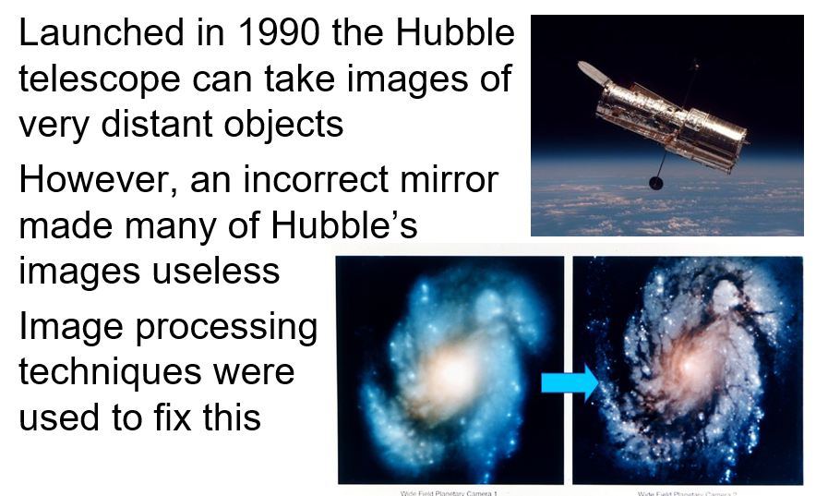
Examples: The Hubble Telescope

Slide 8
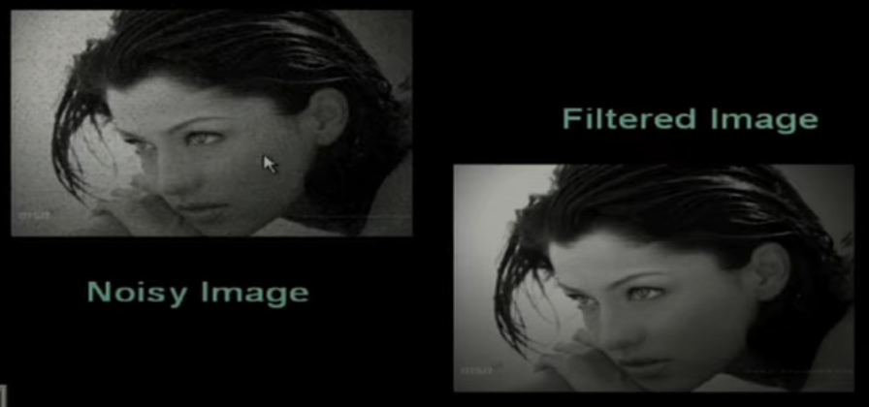
Examples - Filtering

Slide 9
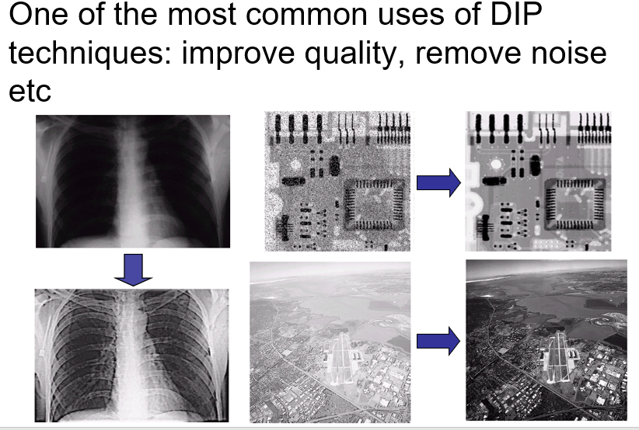
Examples: Image Enhancement

Slide 10
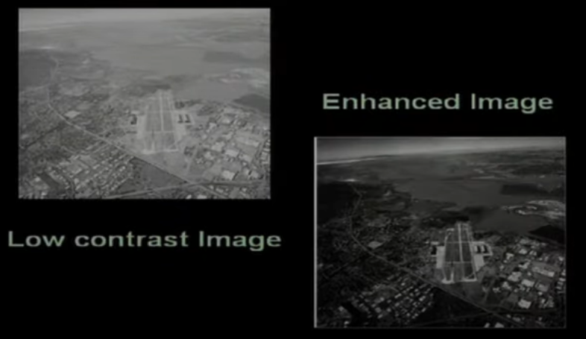
Image Enhancement
See the waterline of the river

Slide 11
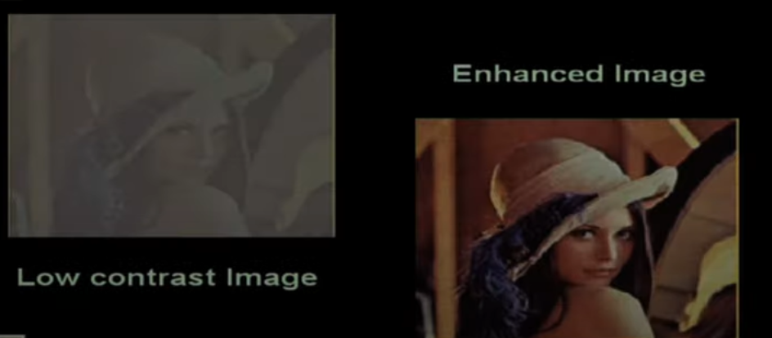
Image Enhancement

Slide 12
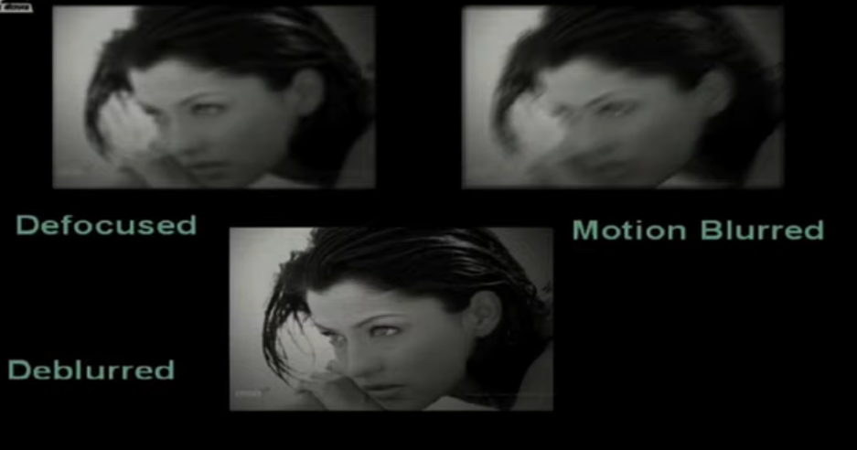
Image Deblurring

Slide 13
Digital Image Processing Real-Life Applications
Medical Technology :
In the medical field, Image Processing is used for various tasks like PET scan, X-Ray Imaging, Medical CT, UV imaging, Cancer Cell Image processing, and much more. The introduction of Image Processing to the medical technology field has greatly improved the diagnostics process.

Slide 14
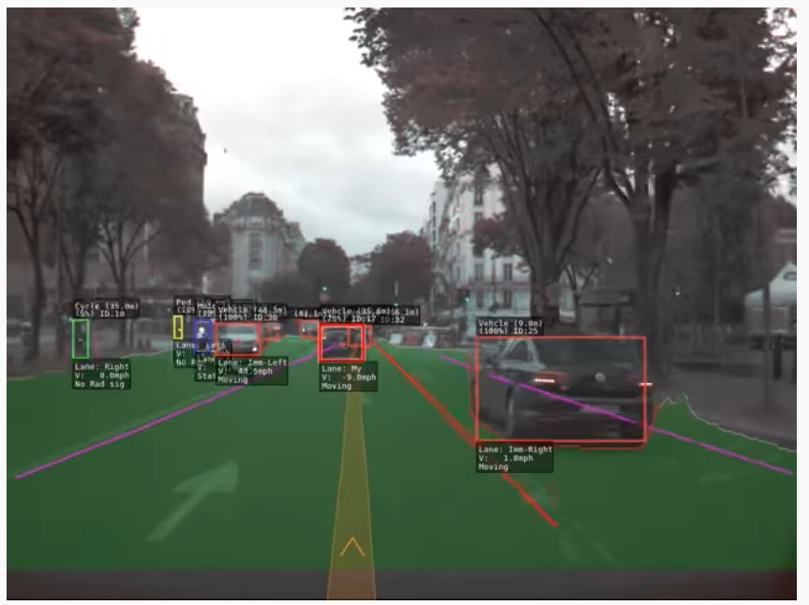
Digital Image Processing Real-Life Applications - Computer / Machine Vision :
One of the most interesting and useful applications of Image Processing is in Computer Vision.
Computer Vision is used to make the computer see, identify things, and process the whole environment as a whole.
An important use of Computer Vision is Self Driving cars, Drones etc. CV helps in obstacle detection, path recognition, and understanding the environment.

Slide 15
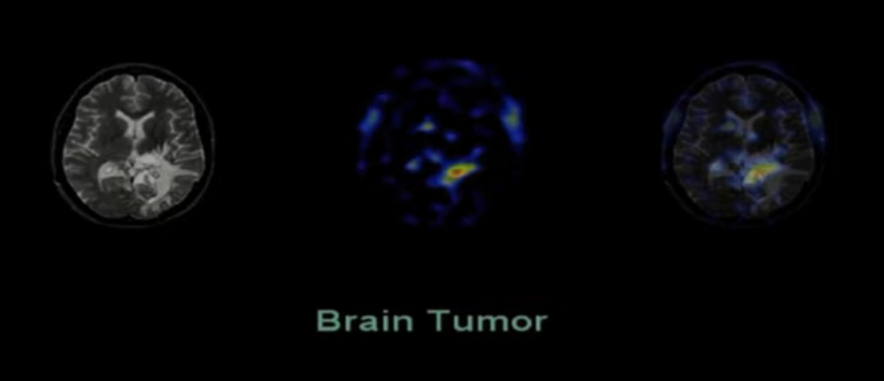
Medical Imaging
Left hand image is Original CT Scan Image– Human Brain
Right hand images are the processed images
Image processing is used to determine the location of a tumor.
Region of yellow and red tells the presence of tumour in the brain
Can detect the exact location and size of the tumour- help the doctor to plan the operations

Slide 16
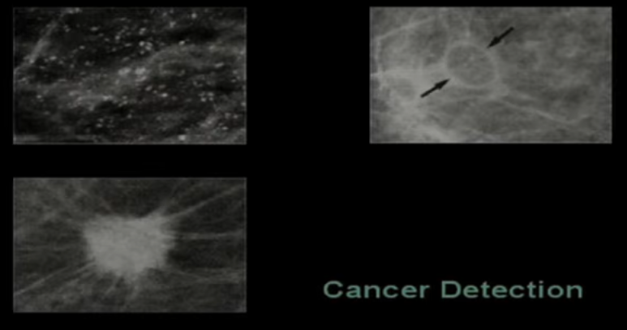
Medical Imaging
Mammogram images which shows the presence of cancerous tissues –
Helpful in detects the formation of cancer tissues

Slide 17
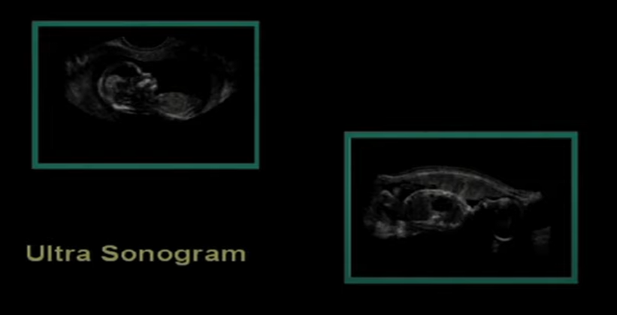
Medical Imaging
To study the growth of a baby in mother’s womb

Slide 18
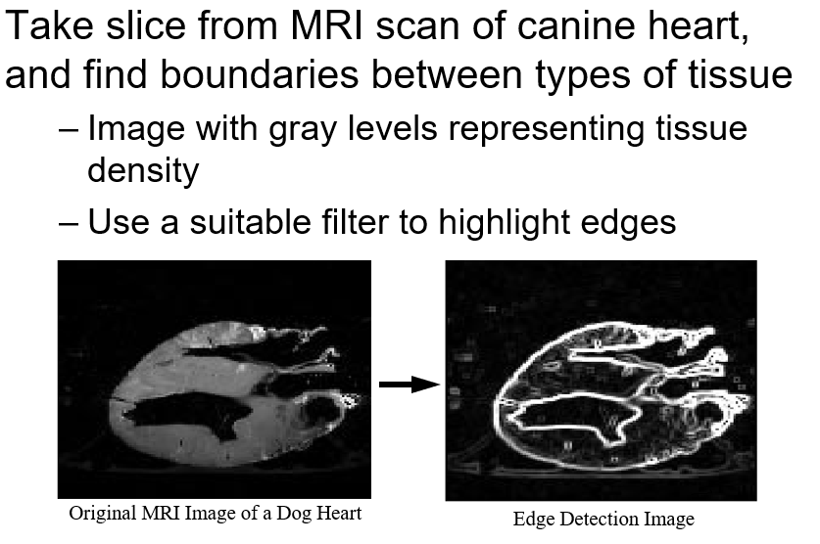
Medical Imaging

Slide 19
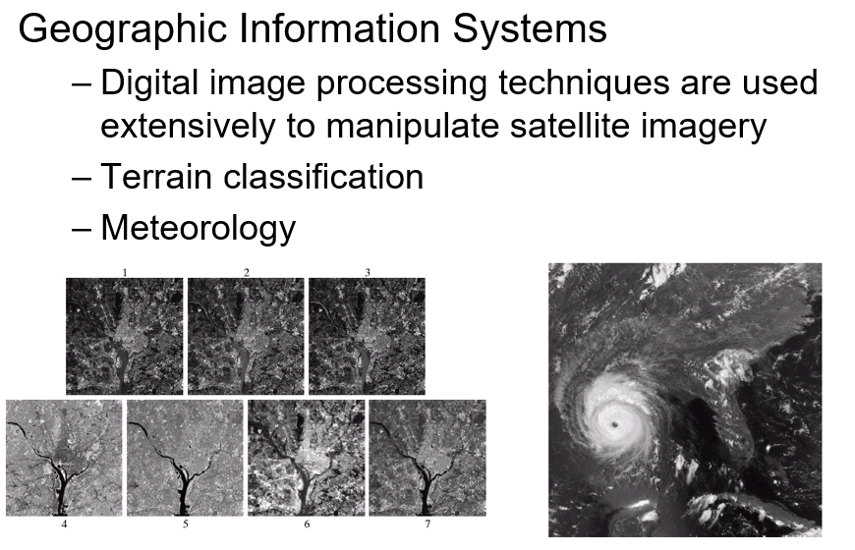
Examples: GIS

Slide 20
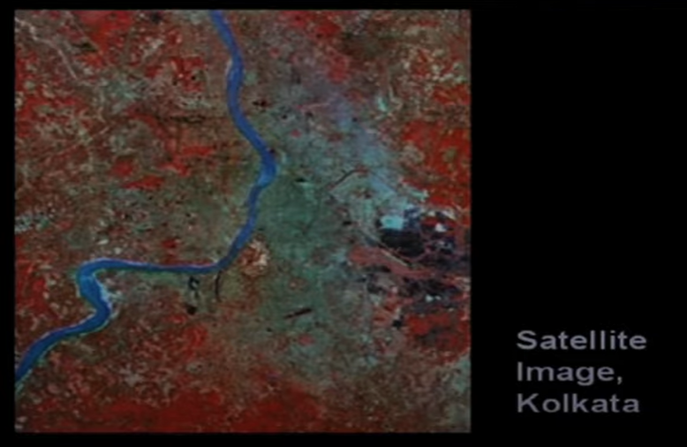
Remote Sensing

Slide 21
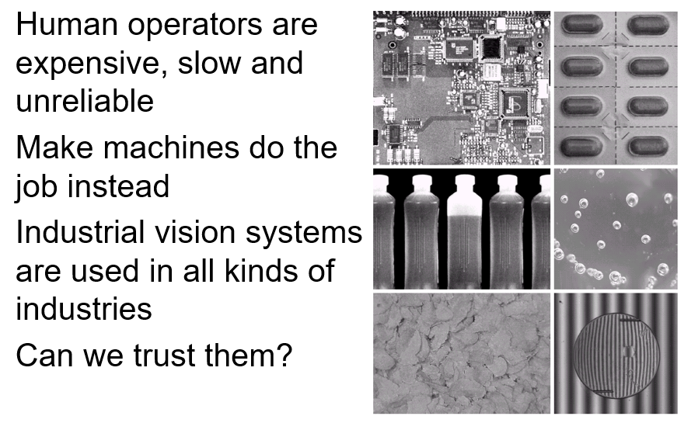
Examples: Industrial Inspection

Slide 22
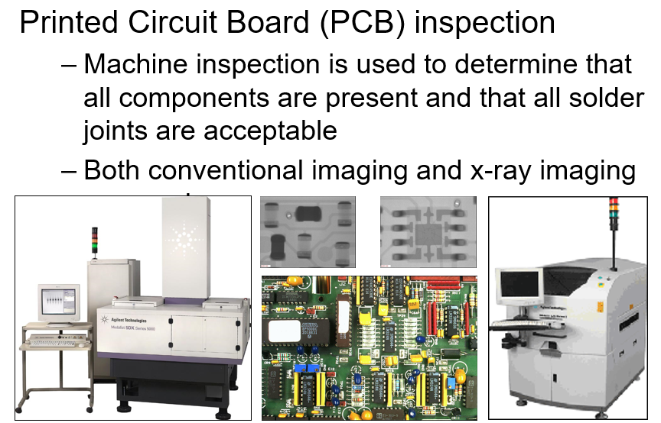
Examples: PCB Inspection

Slide 23

Image Representation
A digital image is a representation of a two-dimensional image as a finite set of digital values, called picture elements or pixels

Slide 24
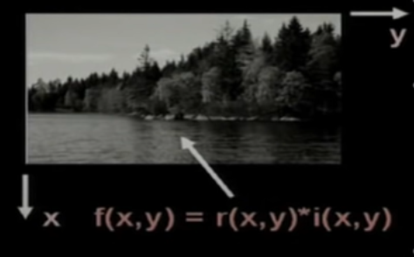
Image Representation
An image is defined as a two-dimensional function, f(x,y), where x and y are spatial coordinates, and the amplitude of f at any pair of coordinates (x,y) is called the intensity of that image at that point.
A digital image f(x,y) is discretized both in spacial coordinates and brightness
it can be considered as a matrix whose row, column indices specify a point in the image and the element value identifies gray level value at that point.
These elements are referred as pixels or pels.
r(x,y) is the reflectivity of the surface of the corresponding image point

Slide 25
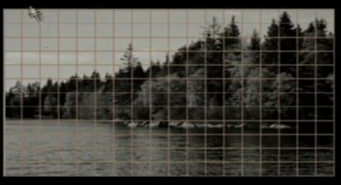
Image Representation
There are infinite no of points in both directions and at every point the intensity value is continuous between 0 and 1. Not possible to store in digital form.
Instead of storing all the intensity values at all possible points in the image, we try to take sample of the image.
Samples- spacial discretization by sampling
Intensity discretization by quantization

Slide 26
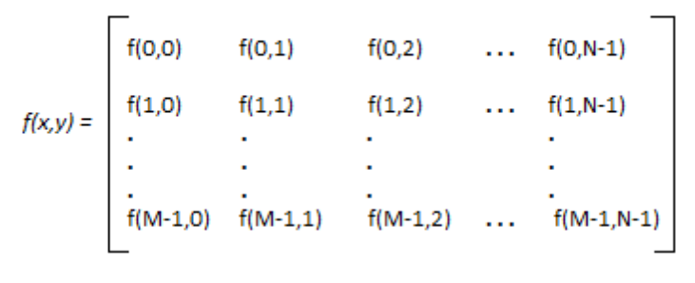
Image Representation - as a Matrix
Each of these sample values are quantized and typically for image processing applications the quantization is done using 8 bits for black and white images. And 24 bits for colored images
Matrix of finite dimensions –each of these elements in this matrix representation is a pixel or pel

Slide 27
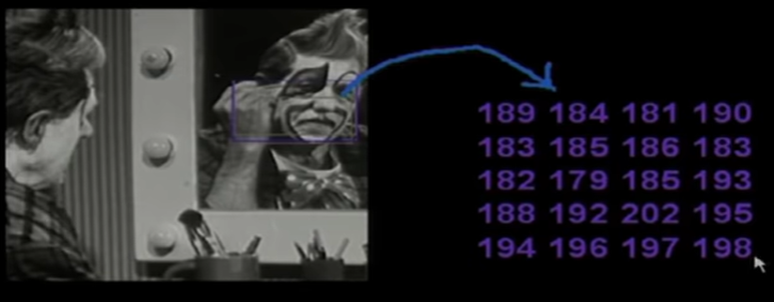
Image Representation - as a Matrix

Slide 28
Sampling and Quantization
In order to become suitable for digital processing, an image function f(x, y) must be digitized both spatially and in amplitude. There are two steps in which it is done:
Sampling: Digitizing the co-ordinate value is called sampling.
Quantization: Digitizing the amplitude value is called quantization.
The sampling rate determines the spatial resolution of the digitized image, while the quantization level determines the number of grey levels in the digitized image.

Slide 29
Sampling and Quantization
Sampling – Finite no of rows and finite no of columns, to represent the image in the form of finite 2-D matrix
Every matrix element represents an intensity value in the corresponding image location, these intensity values can again be infinite between certain minimum and maximum, which is not possible to be represented by a digital computer-
Quantization - So each of the matrix elements has to be digitized so that the intensity value at a particular element can also assume only values from a finite set of discrete values- this is called digitization process

Slide 30
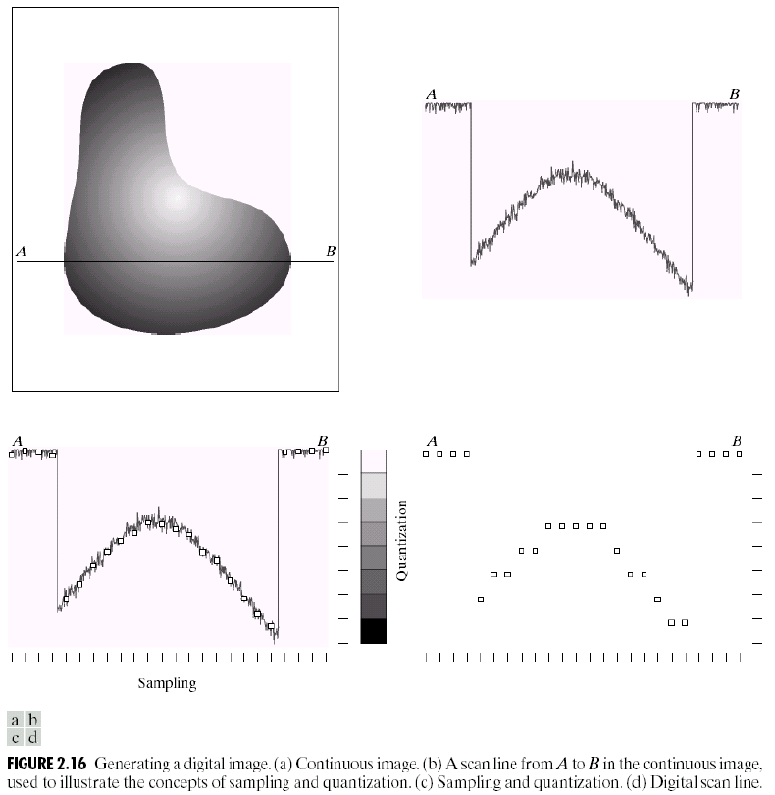

Sampling and Quantization
Generating a digital image. (a) Continuous image. (b) A scaling line from A to B in the continuous image, used to illustrate the concepts of sampling and quantization. (c) sampling and quantization. (d) Digital scan line.

Slide 31


Sampling and Quantization
(a) Continuous image projected onto a sensor array. (b) Result of image sampling and quantization.

Slide 32
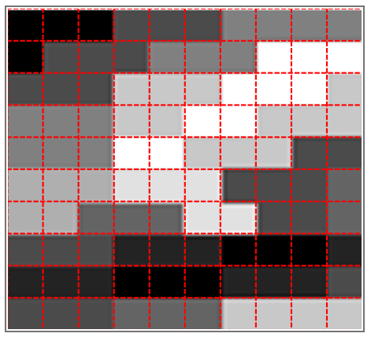
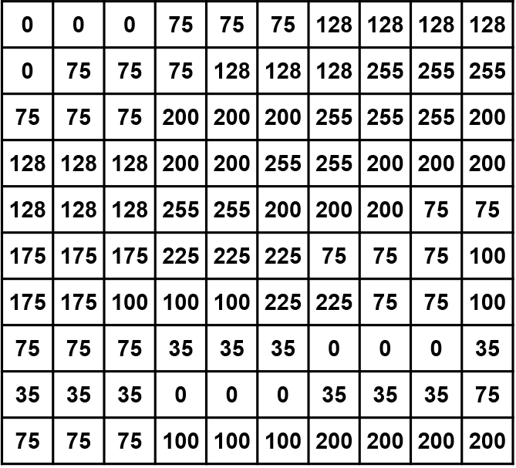
Sampling and Quantization

Slide 33
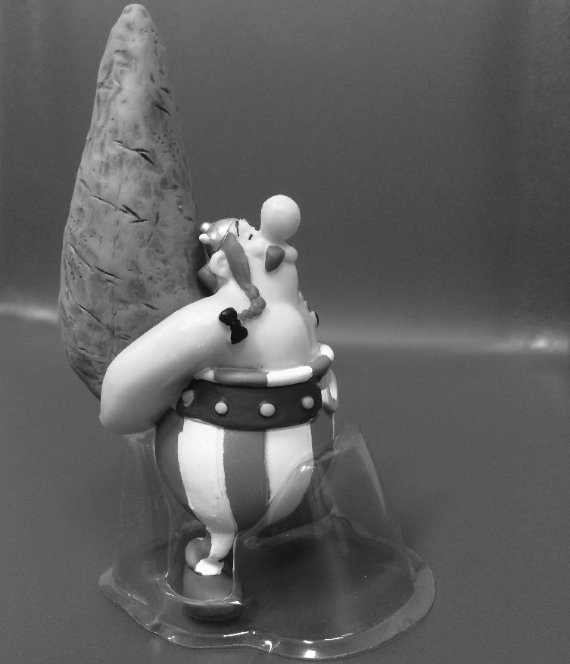
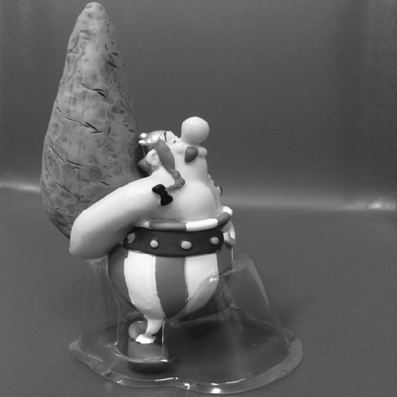

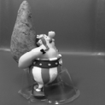

Sampling

Slide 34
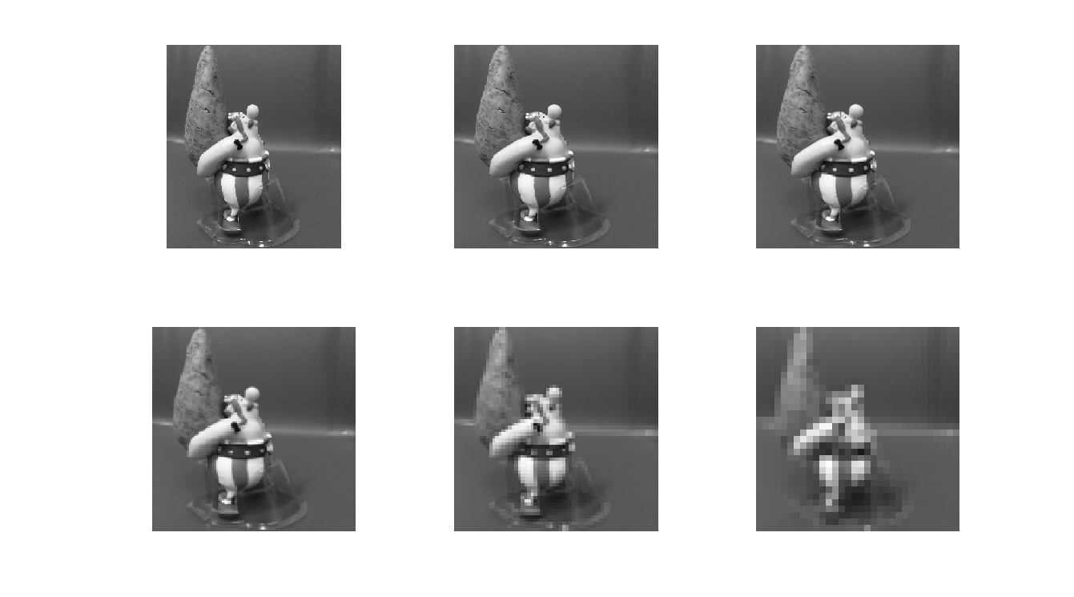
Sampling

Slide 35
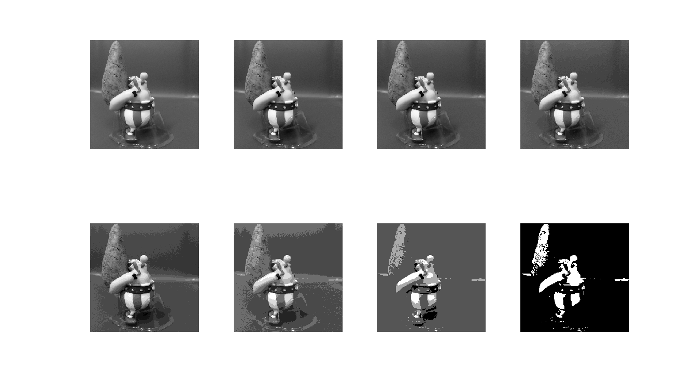
Quantization

Slide 36
Decimation and interpolation
Scaling image down
The process of reducing the raster dimensions is called decimation, this can be done by averaging the values of source pixels contributing to each output pixel.
Image compression
Limited bandwidth image transmission
Protection of copyrighted material- show a low-resolution image of a product(movie)
Scaling image up
When we increase the image size we actually want to create sample points between the original sample points in the original raster, this is done by interpolation the values in the sample grid, effectivly guessing the values of the unknown pixels^{[3]}.
Image resizing -- for enlarging an image or part of an image.
Image restoration after compression

Slide 37
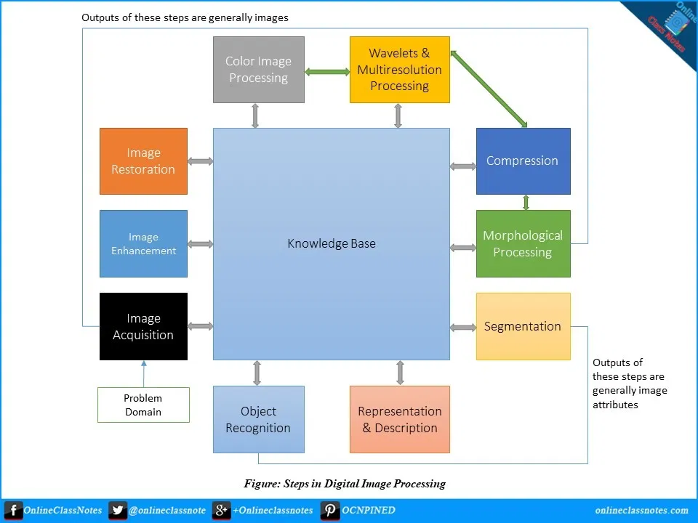
Steps in Digital Image processing

Slide 38
Steps in Digital Image processing
Digital Image Processing Involves following basic Tasks-
1. Image Acquisition-
Image acquisition could be as simple as being given an image that is already in digital form. Generally, the image acquisition stage involves pre-processing, such as scaling etc.
2. Image Enhancement
Basically, the idea behind enhancement techniques is to bring out detail that is obscured, or simply to highlight certain features of interest in an image. Such as, changing brightness & contrast etc.

Slide 39
Steps in Digital Image processing
3. Image Restoration
unlike enhancement, which is subjective, image restoration is objective. Restoration techniques tend to be based on mathematical or probabilistic models of image degradation.
4. Color Image Processing-
It deals with pseudocolor and full color image processing color models are applicable to digital image processing.
5. WAVELETS AND MULTI-RESOLUTION PROCESSING–
It is foundation of representing images in various degrees of resolution. It is used for image data compression

Slide 40
Steps in Digital Image processing
6. Compression-
Compression deals with techniques for reducing the storage required to save an image or the bandwidth to transmit it.
7. Morphological Processing-
Morphological processing deals with tools for extracting image components that are useful in the representation and description of shape
8. Segmentation-
Segmentation procedures partition an image into its constituent parts or objects.

Slide 41
Steps in Digital Image processing
9. Representation and Description
Representation and description almost always follow the output of a segmentation stage, which usually is raw pixel data, constituting either the boundary of a region or all the points in the region itself.
10. Object Detection and Recognition-
It is a process that assigns a label to an object based on its descriptor.
11. Knowledge Base -
Knowledge may be as simple as detailing regions of an image where the information of interest is known to be located, thus limiting the search that has to be conducted in seeking that information.

Slide 42
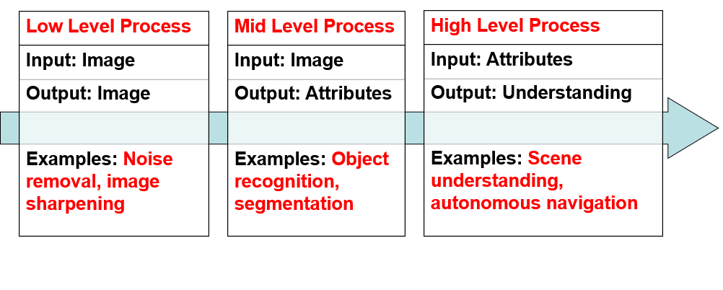
OVERLAPPING FIELDS WITH IMAGE PROCESSING The continuum from image processing to computer vision can be broken up into low-, mid- and high-level processes
Computer Graphics: The creation of images
Image Processing: Enhancement or other manipulation of the image
Computer Vision: Analysis of the image content

Slide 43
image processing to computer vision
1. Low level Processes
Input and output are images
Tasks: Primitive operations, such as, image processing to reduce noise, contrast enhancement and image sharpening
2. Mid-Level Processes
Inputs, generally, are images. Outputs are attributes extracted from those images (edges, contours, identity of individual objects)
Tasks: Segmentation (partitioning an image into regions or objects), Description of those objects to reduce them to a form suitable for computer processing, Classifications (recognition) of objects
3. High-Level Processes: – Image analysis and computer vision

Slide 44
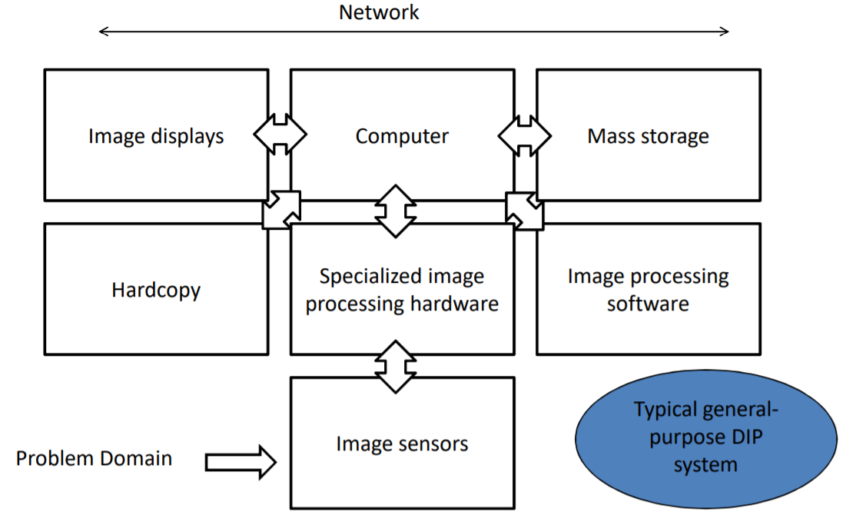
Components of an Image Processing System

Slide 45
Components of an Image Processing System
Image Sensors
Two elements are required to acquire digital images. The first is the physical device that is sensitive to the energy radiated by the object we wish to image (Sensor).
The second, called a digitizer, is a device for converting the output of the physical sensing device into digital form.

Slide 46
Components of an Image Processing System
2. Specialized image processing hardware usually consists of the digitizer plus hardware that performs other primitive operations such as arithmetic and logical operations (ALU). Eg. Noise reduction. This type of hardware sometimes is called a front end subsystem.
3. Computer The computer in an image processing system is a general-purpose computer and can range from a PC to a supercomputer. In dedicated applications, sometimes specially designed computers are used to achieve a required level of performance.

Slide 47
Components of an Image Processing System
4. Image Processing Software-
Software for image processing consists of specialized modules that perform specific tasks. A well-designed package also includes the capability for the user to write code that, as a minimum, utilizes the specialized modules

Slide 48
Components of an Image Processing System
5. Mass Storage Capability –
Mass storage capability is a must in a image processing applications. And image of sized 1024 * 1024 pixels requires one megabyte of storage space if the image is not compressed.
Digital storage for image processing applications falls into three principal categories:
Short-term storage for use during processing.
On line storage for relatively fast recall
Archival storage, characterized by infrequent access

Slide 49
Components of an Image Processing System
6. Image Displays –
The displays in use today are mainly color (preferably flat screen) TV monitors. Monitors are driven by the outputs of the image and graphics display cards that are an integral part of a computer system.
7. Hardcopy devices Used for recording images, include laser printers, film cameras, heat-sensitive devices, inkjet units and digital units, such as optical and CD-Rom disks.
8. Networking Is almost a default function in any computer system, in use today. Because of the large amount of data inherent in image processing applications the key consideration in image transmission is bandwidth.

Slide 50
Elements of Visual perception
The retina-
When the eye is properly focused, light from an object outside the eye is imaged on the retina
Pattern vision is possible by the distribution of discrete light receptors (a sense organ in the body that makes the body react in a particular way to changes outside such as light, heat and cold) over the surface of the retina.
There are two classes of receptors –
Cones vision (called photopic/bright-light vision)
Rods Vision (Called Scotopic/dim-light vision)

Slide 51
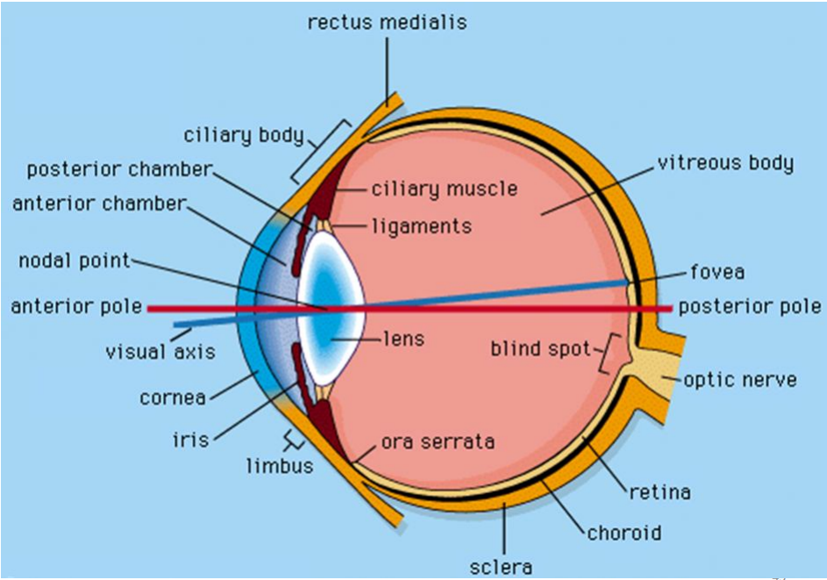

Slide 52
Elements of Visual perception
Cones vision (called photopic/bright-light vision)-
Numbers between 6 and 7 million in each eye
highly sensitive to color,
Human can resolve fine details with these cones
2. Rods Vision (Called Scotopic/dim-light vision)
The no of rods is much larger 75 to 150 million are distributed over the retinal surface
Rods serves to give a general overall picture of the view
Sensitive to low levels of illuminations
For eg, objects that appears bright in day light appears as colorless in moonlight because only the rods are stimulated. This phenomenon is known as scotopic or dim light vision

Slide 53
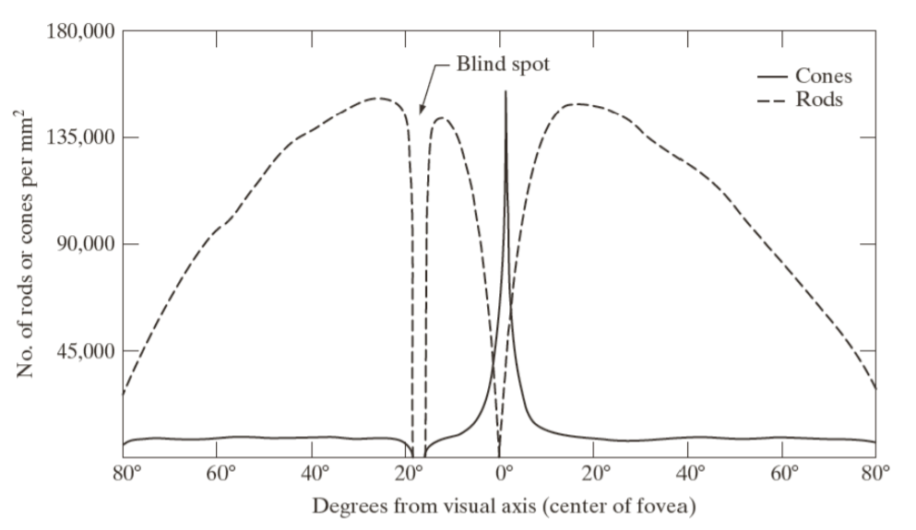
Cones vs. Rods
Receptor density is measured in degrees

Slide 54
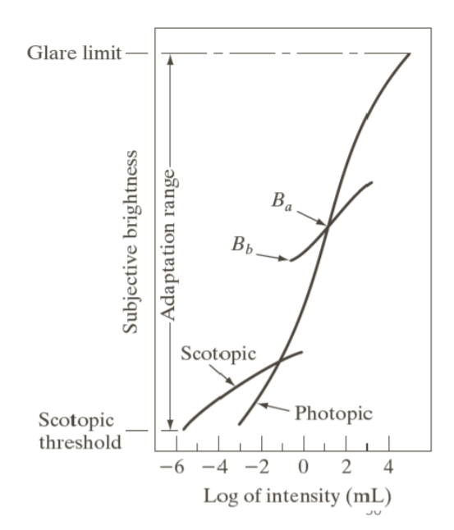
Brightness Adaptation
The range of light intensity level to which the human visual system can adapt is enormous – on the order of 10¹⁰ from the scotopic threshold to the glare limit
Subjective brightness is a logarithmic function of the light intensity incident on the eye.

Slide 55
Brightness Adaptation
The long solid curve shows the range of intensities to which the visual system can adapt
The transition from scotopic to photopic vision is gradual over the appx range from 0.001 to 0.01(–3 to –1 mL in the log scale) millilambert, as the double branches of the adaptation curve in this range shows.
The visual system cannot accomplish this range simultaneously
Rather, It accomplishes this large variation by changing its overall sensitivity, a phenomenon known as brightness adaptation
The current sensitivity level of the visual system is called the brightness adaptation level
Light intensity vs. subjective brightness

Slide 56
Brightness Adaptation
The ability of the eye to discriminate between in light intensity at any specific adaptation level is also of considerable interest .
A classic experiment used to determine the capability of the human visual system for brightness discrimination consists of having a subject look at a flat, uniformly illuminated area large enough to occupy the entire field of view.
This area typically is a diffuser, such as opaque glass, that is illuminated from behind by a light source whose intensity, I, can be varied. To this field is added an increment of illumination, I, in the form of a short-duration flash that appears as a circle in the center of the uniformly illuminated field, as Fig. 2.5 shows

Slide 57
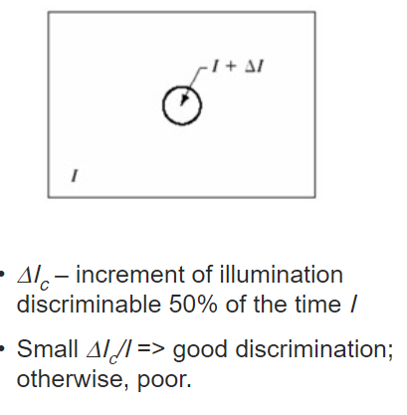
Brightness Adaptation
The ability of the eye to discriminate between in light intensity at any specific adaptation level is also of considerable interest .
Weber ratio (the experiment) ΔI_{c} /I
I: the background illumination
ΔI c : the increment of illumination
Small Weber ratio indicates good discrimination
Larger Weber ratio indicates poor discrimination
FIGURE 2.5 Basic experimental setup used to characterize brightness discrimination.

Slide 58
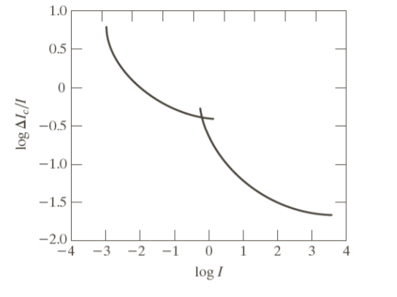
Brightness Adaptation
If ΔI is not bright enough, the subject says NO indicating no perceivable change.
As ΔI gets stronger, the subject may give a positive response indicating a perceivable change.
Finally when ΔI is strong enough, the subject will give a response of yes all the time.
The quantity ΔI_{c}/I, where Δi_{c} is the increment of illumination discriminable 50% of the time with background illumination I, is called the Weber Ration.

Slide 59
Image Sensing and Acquisition
Most of the images are generated by combination of an “illumination” source and the reflection and absorption of energy from that source by the element of the “scene” being imaged.
The illumination may originate from a source of electromagnetic energy such as radar, infrared, or X- ray system, or a less traditional source such as ultrasound.
Similarly the scene objects can also be molecules, buried rock formation, or a human brain.
Depending upon the nature of the source, illumination energy is reflected from or transmitted through objects.

Slide 60
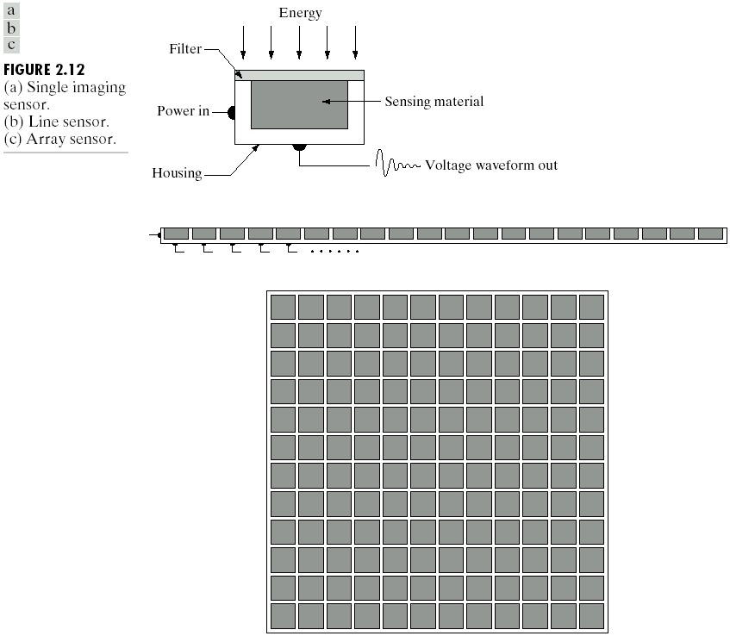
Figure shows the three principal sensor arrangements used to transform illumination energy into digital images
Types of Image Sensors
Single Sensor
Line Sensor
Array Sensor

Slide 61
Image Sensing and Acquisition
Incoming energy is transformed into voltage by the combination of input electrical power and sensor that is responsive to the particular type of energy being detected.
The output voltage wave form is the response of the sensors
The images are generated by the combination of an illumination source and the reflection or absorption of energy from that source by the elements of the scene being imaged.
Imaging sensors are used to transform the illumination energy into digital images.

Slide 62
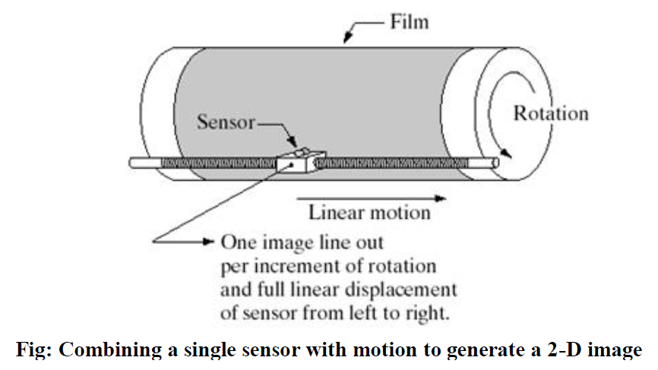
Image Acquisition using a single sensor
Most familiar sensor of this type is photodiode, which is constructed of silicon material and its output voltage waveform is proportional to light.
The use of a filter in front of a sensor improves selectivity.
For example, a green (pass) filter in front of a light sensor favours light in the green band of the color spectrum.

Slide 63
Image Acquisition using a single sensor
In order to generate a 2-D image using a single sensor, there have to be relative displacements in both the x- and y-directions between the sensor and the area to be imaged.
An arrangement used in high precision scanning, where a film negative is mounted onto a drum whose mechanical rotation provides displacement in one dimension.
The single sensor is mounted on a lead screw that provides motion in the perpendicular direction. Since mechanical motion can be controlled with high precision, this method is an inexpensive (but slow) way to obtain high-resolution images.

Slide 64
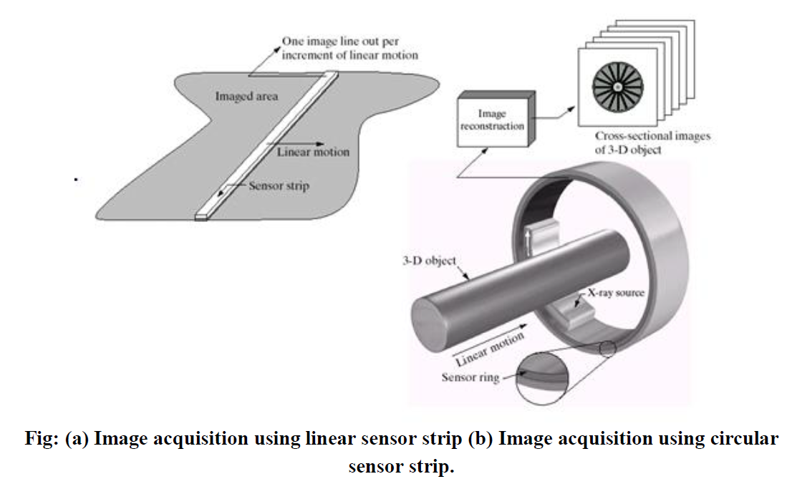
Image Acquisition using Sensor Strips

Slide 65
Image Acquisition using Sensor Strips
A geometry that is used much more frequently than single sensors consists of an in-line arrangement of sensors in the form of a sensor strip.
The strip provides imaging elements in one direction.
Motion perpendicular to the strip provides imaging in the other direction
This is the type of arrangement used in most flat bed scanners.
In-line sensors are used routinely in airborne imaging applications, in which the imaging system is mounted on an aircraft that flies at a constant altitude and speed over the geographical area to be imaged.

Slide 66
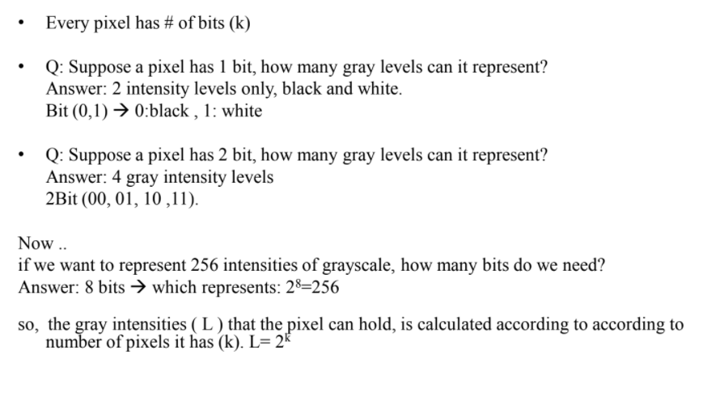
Pixels!!!

Slide 67
